Slide 1

Introduction to Computational Thinking
Isaac Alpizar-Chacon
INFOB1CODE - Computational thinking

Slide 2

1

Slide 3
Today’s lecture
Definition of Computational Thinking
Definition of Information Retrieval
Relation of Computational Thinking and Information Retrieval
1

Slide 4
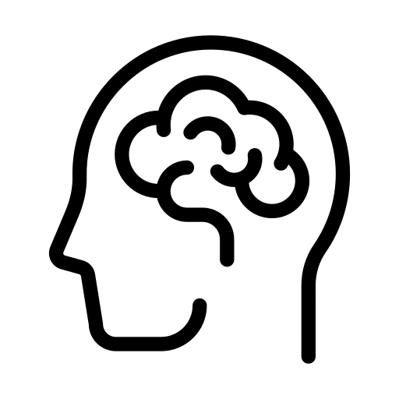
What do we mean by computational thinking?
Brain icon: Flaticon.com
1

Slide 5
Computational Thinking: definition
Jeanette Wing (2014):
Computational thinking (CT) is the thought processes involved in formulating a problem and expressing its solution(s) in such a way that a computer—human or machine—can effectively carry out.
Wing, J. (2014). Computational thinking benefits society. 40th Anniversary Blog of Social Issues in Computing, 2014.
5

Slide 6
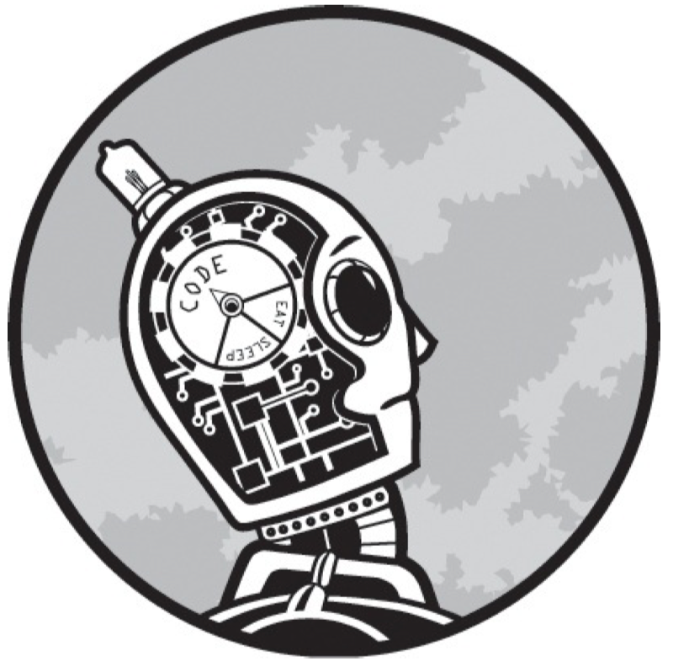
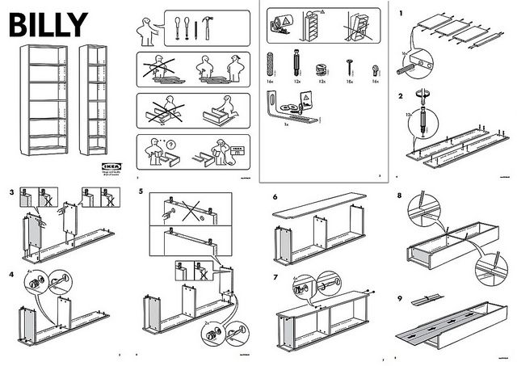
… is not trying to get humans to think like computers
… is a way humans solve problems
Robot: Spraul, V. A. (2017). Think like a programmer: A beginner's guide to programming and problem solving. No Starch Press.
Billy: https://cdn.frankwatching.com/app/uploads/2016/09/instructions_IKEA_billy-295x209.jpg
5

Slide 7
Computational Thinking: application
For complex processes, daily processes, multiple disciplines:
break it down into smaller steps
find repetitions, similarities between steps (patterns)
join steps together that lead to a goal
5

Slide 8
Algorithm: definition
Donald Knuth (1977):
An algorithm is a set of rules for getting a specific output from a specific input. Each step must be so precisely defined that it can be translated into computer language and executed by machine.
8

Slide 9
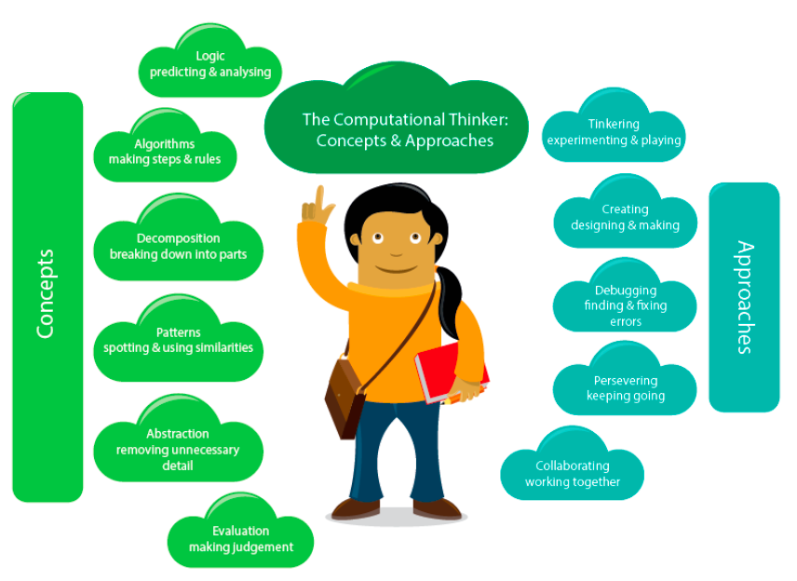
8
A. Csizmadia et al., "Computational thinking-A guide for teachers," 2015.

Slide 10

Computational Thinking in the kitchen
Algorithm: the recipe
Decomposition: making the different parts of the dish
Generalization and patterns: baking, cutting, making sauce
Abstraction: measuring ingredients
Evaluation: checking, tasting
Chef icon: Flaticon.com
8

Slide 11

Computational Thinking Concepts Public Transport Example
Bus icon: Flaticon.com
8

Slide 12
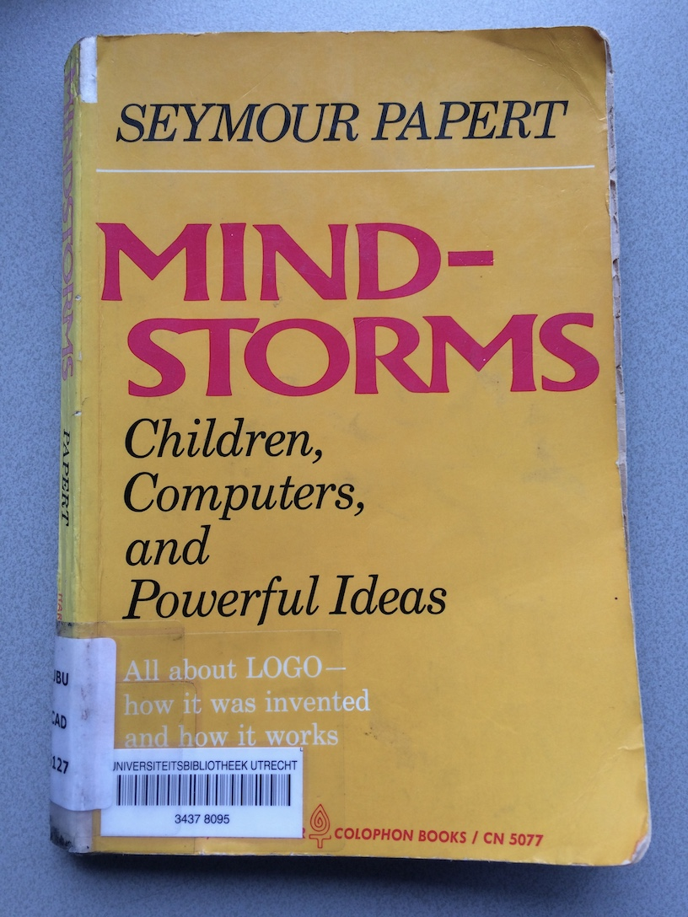
The concept of ‘computational thinking'
Goes back to work Seymour Papert (1980)
'collaboration of computers and children'
learn by doing
LOGO programming language in the 1960’s.
thinking mathematically and logically
Later (1996), referenced as “procedural thinking”
8

Slide 13
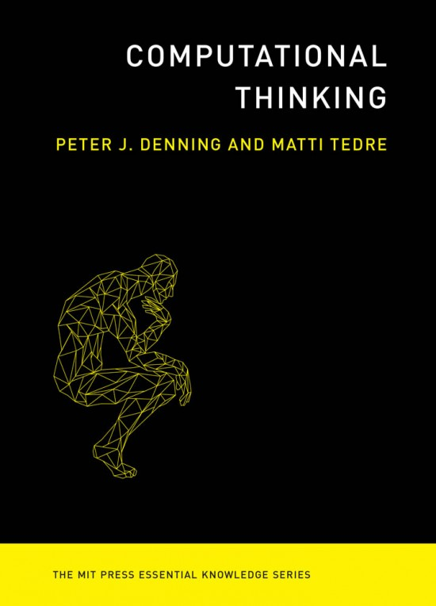
Another definition: Denning and Tedre (2019)
Computational thinking is the mental skills and practices for
designing computations that get computers to do jobs for us, and
explaining and interpreting the world as a complex of information processes
Rather high-level definition
designing corresponds to the definition of Wing (2014)
explaining and interpreting the world… important, but very ambitious—we scale that back a bit in this course
13

Slide 14
The power of Computational Thinking
Figuring out how to get a computer to do a job for us
Learning how the world works
Advising us about jobs that computers cannot do in any reasonable amount of time
Knowing that a machine does a job without error
13

Slide 15
Computational thinking in Information Science
According to Denning and Tedre, computational thinking is shaped by the context
What is computational thinking within Information Science?
Information science investigates how ICT interacts with people and organizations, and designs solutions to improve this interaction
Computational thinking here is designing and understanding ICT in relation to people, organizations and society
13

Slide 16
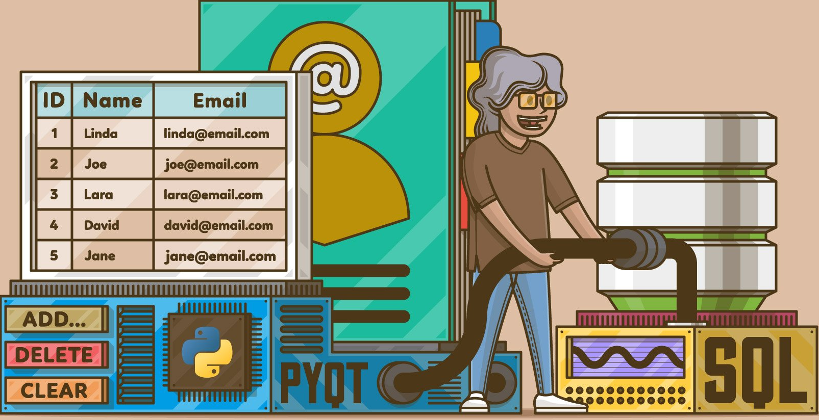
Computational thinking in CODE
design: programming in Python
part of your material knowledge as an 'architect of ICT solutions'
empowerment: application in e.g. data analysis, design, prototyping, experimental research…

Slide 17
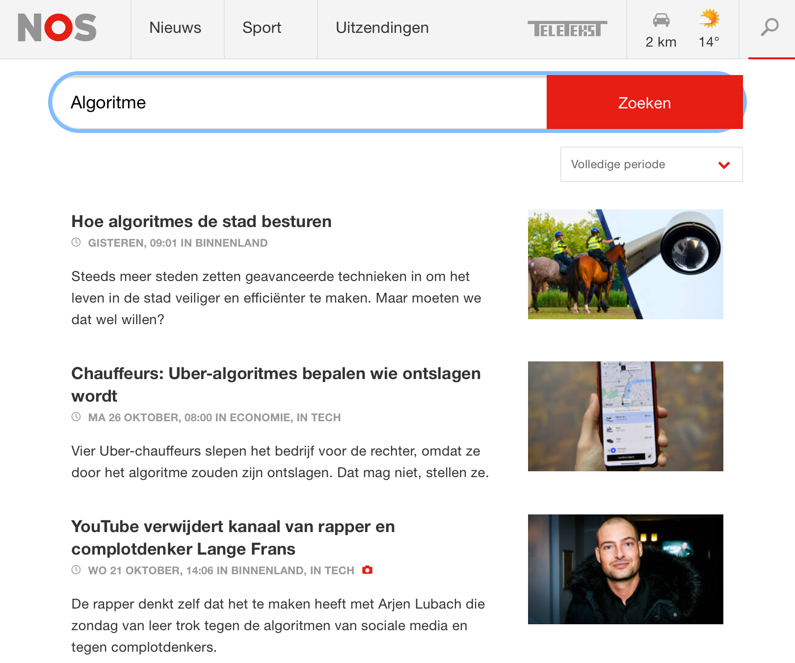
Computational thinking in CODE
explain and interpret: being able to analyze and explain how computer systems work
being able to convey insight into the possibilities and impossibilities of ICT
demystifying technology is a major social task
see AI, fake news, search engines, personalization

Slide 18

Special theme: Information Retrieval
Information Retrieval (IR) is concerned with designing search technology
If somewhere people and machines come together it is here
Search technology has changed the world
Google (to find everything)
Spotify (playlists)
Amazon (web stores)
Social media (networking, sharing news)
Image: https://www.searchenginejournal.com/alternative-search-engines/271409/

Slide 19
Special theme: Information Retrieval
Can you explain how these systems work?
we will study a number of underlying principles, models and algorithms
‘human search engine’ assignments: computational thinking in the domain of IR
Final project: build your own IR application in Python

Slide 20
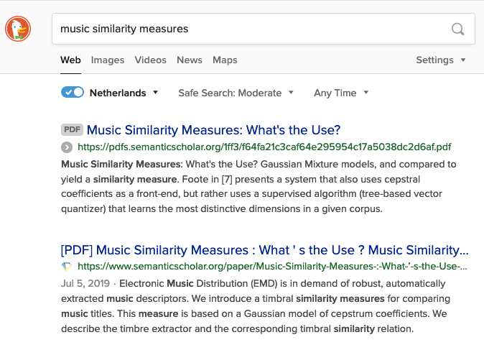
Computational thinking in IR
decomposition ('divide and conquer'): what steps does the search process consist of?
algorithmic thinking: how do you compare a search query with a document?
generalization: what are the similarities and differences between media, languages,…
abstraction: how does the system 'see' a document?
algorithmic thinking: how do you order the results?
evaluation: how do you measure how well the system works?
https://duckduckgo.com/
Notes:
<number>

Slide 21
Additional material (optional, motivation)
Computational thinking
Computational Thinking - Jeannette M. Wing (https://www.cs.cmu.edu/afs/cs/Web/People/15110-s13/Wing06-ct.pdf)
Computational Thinking in Science - Peter J. Denning (https://www.americanscientist.org/article/computational-thinking-in-science)
Programming
How Programming Affects Your Brain: 3 Big Truths Backed by Science (https://javascript.plainenglish.io/how-programming-affects-your-brain-fedea6b02f85)
To the brain, reading computer code is not the same as reading language (https://news.mit.edu/2020/brain-reading-computer-code-1215)
How is the brain programmed for computer programming? (http://www.naist.jp/en/research_achievements/2021/01/007616.html)
19

Slide 22
Next lecture
Date
Wednesday 23/11
Topic
Information Retrieval Systems
Reading
Manning, C. D., Raghavan, P., & Schütze, H. (2018). Introduction to information retrieval. Cambridge University Press.
Chapter 1
https://nlp.stanford.edu/IR-book/pdf/01bool.pdf
22

Slide 23
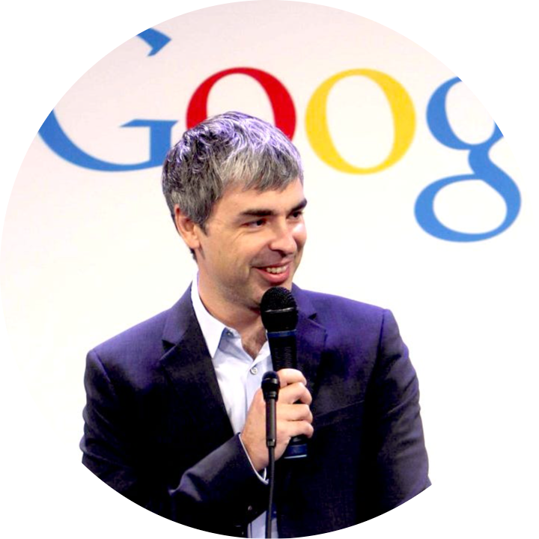

Slide 24
Are you the next Larry Page?

Slide 25
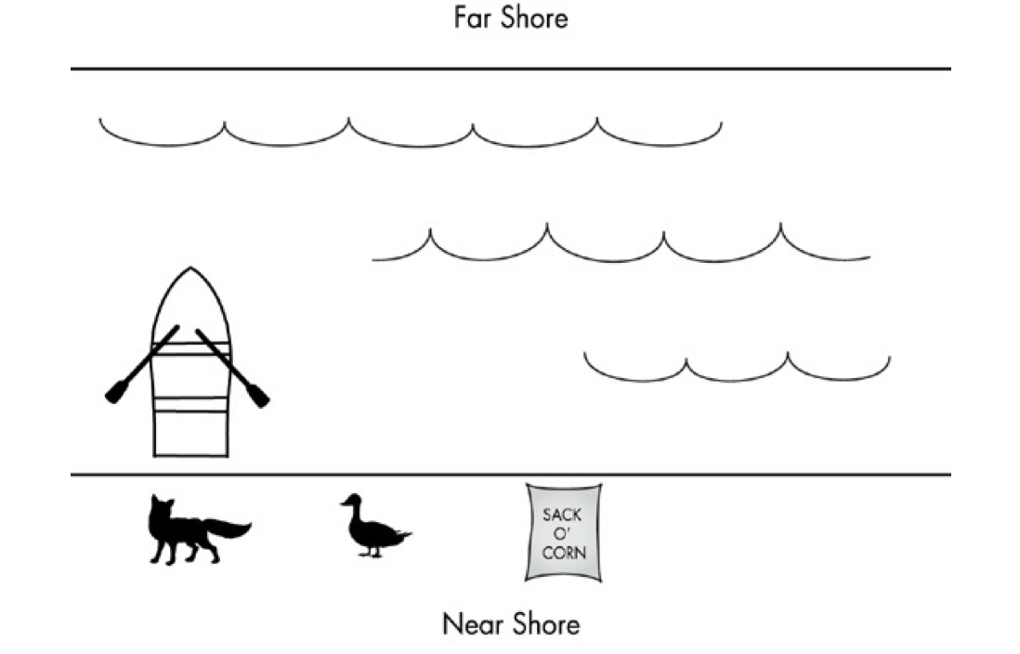
Problem Solving
The Fox, the Goose, and the Corn
Figure 1-1: Spraul, V. A. (2019). Think like a programmer. No starch press.
<number>

Slide 26
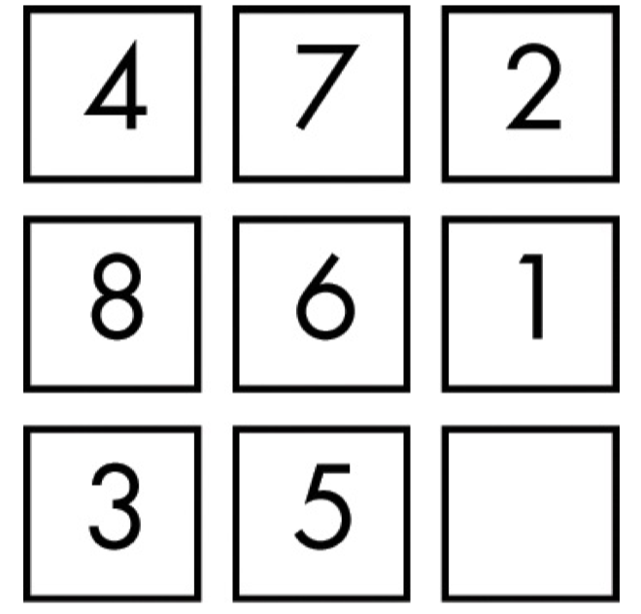
Problem Solving
Sliding Tile Puzzles
Figure 1-5: Spraul, V. A. (2019). Think like a programmer. No starch press.
<number>

Slide 27
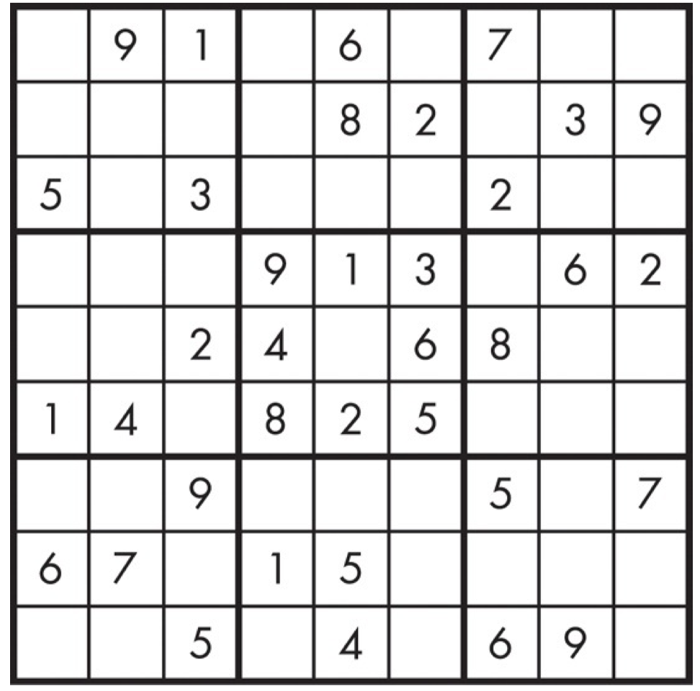
Problem Solving
Sudoku
Figure 1-11: Spraul, V. A. (2019). Think like a programmer. No starch press.
<number>

Slide 28

Problem Solving Techniques
Bus icon: Flaticon.com
<number>

Slide 29
Problem Solving Techniques
Always Have a Plan
Restate the Problem
Divide the Problem
Start with What You Know
Reduce the Problem
Look for Analogies
Experiment
Don’t Get Frustrated
<number>

Slide 30
Additional material (optional, motivation)
Computational thinking
Computational Thinking - Jeannette M. Wing (https://www.cs.cmu.edu/afs/cs/Web/People/15110-s13/Wing06-ct.pdf)
Computational Thinking in Science - Peter J. Denning (https://www.americanscientist.org/article/computational-thinking-in-science)
Programming
How Programming Affects Your Brain: 3 Big Truths Backed by Science (https://javascript.plainenglish.io/how-programming-affects-your-brain-fedea6b02f85)
To the brain, reading computer code is not the same as reading language (https://news.mit.edu/2020/brain-reading-computer-code-1215)
How is the brain programmed for computer programming? (http://www.naist.jp/en/research_achievements/2021/01/007616.html)
<number>

Slide 31
Next lecture
Date
Wednesday 23/11
Topic
Information Retrieval Systems
Reading
Manning, C. D., Raghavan, P., & Schütze, H. (2018). Introduction to information retrieval. Cambridge University Press.
Chapter 1
https://nlp.stanford.edu/IR-book/pdf/01bool.pdf
<number>

